Slide 1
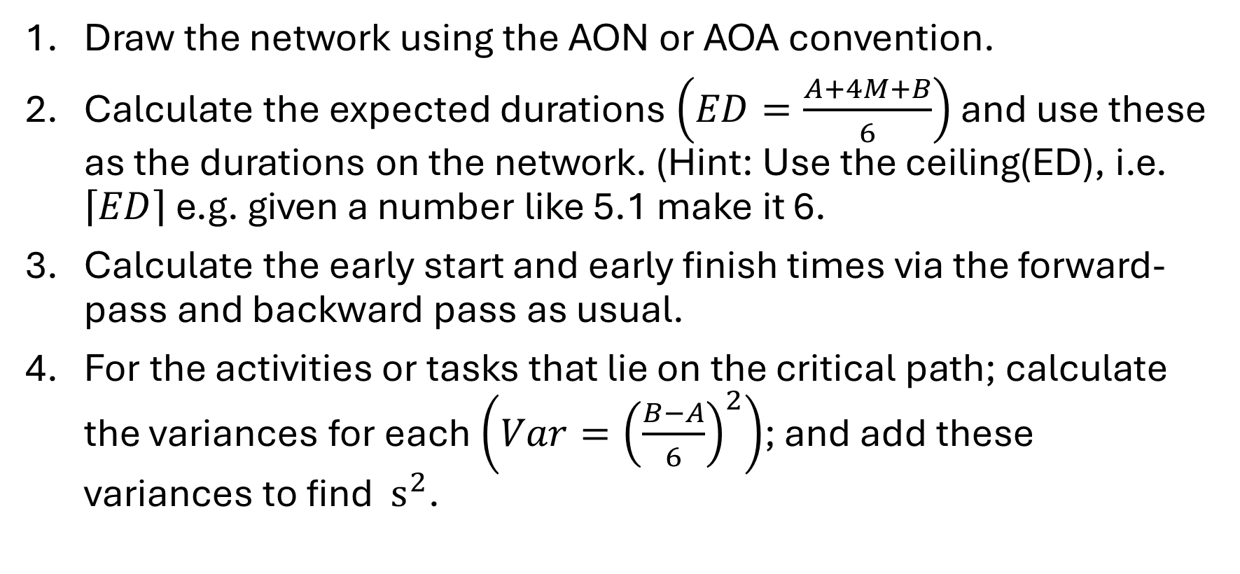
PERT calculation process summary
Draw the network using the AON or AOA convention.
Calculate the expected durations $\left(ED=\frac{A+4M+B}{6}\right)$ and use these as the durations on the network. (Hint: Use the ceiling(ED), i.e. $\left\lceil ED\right\rceil$ e.g. given a number like 5.1 make it 6.
Calculate the early start and early finish times via the forward-pass and backward pass as usual.
For the activities or tasks that lie on the critical path; calculate the variances for each $\left(Var={\left(\frac{B−A}{6}\right)}^{2}\right)$; and add these variances to find $s^{2}$.

Slide 2
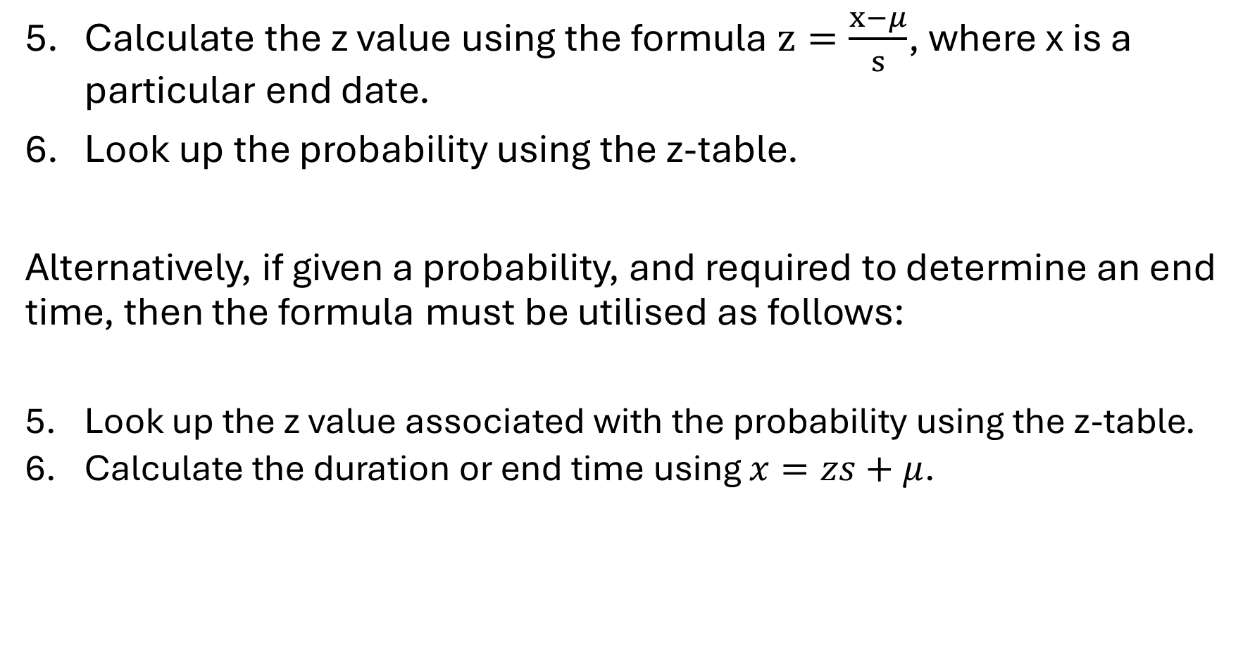
Calculate the z value using the formula $z=\frac{x−μ}{s}$, where x is a particular end date.
Look up the probability using the z-table.
Alternatively, if given a probability, and required to determine an end time, then the formula must be utilised as follows:
Look up the z value associated with the probability using the z-table.
Calculate the duration or end time using $x=zs+μ$.

